Slide 1
Social Media Recommendation
Team ID:-17
Neal Gandhi
Jainam Shah
Sarthak Musale

Slide 2

About the project
Our projcet is based on creating a social media recommendation system to recommend the top 10 posts of the given user based on two filters created & liked posts by user involves several steps, including data preprocessing, feature engineering, model selection.

Slide 3
Approach to Solution
01
02
03
04
05
06
Recommend Algorithms
Create user item interaction
User Interface
Data Explore
Evaluate Modules
Monitor & Interact

Slide 4
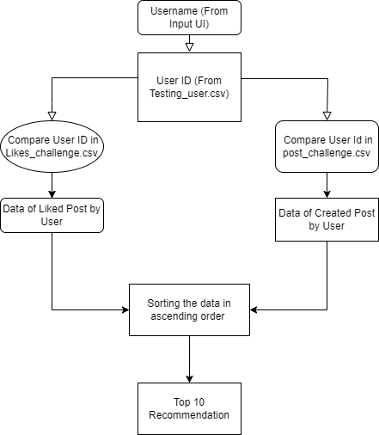
Algorithm
Based on the user name given in the input the dataset like_challenge & post_challenge will be iterated based on user id & selected category. This data will be sorted in ascending order & top 10 post will be recommendation post.

Slide 5
Tools & Modules
02
To Evaluate the results based on the algorithm the Singular Value Decomposition model has been used in the system .

Slide 6
User item Interaction Matrices
To get accurate & scalable data the matrix used is : the user id, id of created post and liked post by user.

Slide 7
Thanks !

